Slide 1

Exploring the Spotify Artist Network: A Comprehensive Analysis and Network-based Insights

Slide 2
Table of contents
01
Introduction
03
Discussion
02
Background, Objectives,
Visualization and insights
Methodology
Data collection, Network construction and analysis, and visualization

Slide 3
01
Introduction

Slide 4
Background
Digital music platforms like Spotify provide vast amounts of data on musical preferences and artist relationships.
Network analysis offers a powerful framework for studying complex relationships in the music industry.

Slide 5
Objectives
This research analyzes artist relationships using the Spotify API to construct a network based on shared fanbases.
The objective is to investigate the interconnectedness of artists and identify prominent clusters and influential figures.
Python and data analysis libraries are used to connect with the Spotify API and perform analyses on the dataset.
The research aims to uncover insights into artist connections, identify influential figures, and impact music recommendation systems and artist collaborations.

Slide 6
02
Methodology

Slide 7
Methodology
Data Collection
01
02
Network Construction
04
03
Network Analysis
Visualization

Slide 8
Data Collection
First step was:
Scraping Last.fm for Artist Names by Nationality:
Utilized BeautifulSoup library to extract artist names based on nationality.
Defined a list of nationalities: United States, United Kingdom, Canada, and Australia.
Sent requests to Last.fm artists pages for each nationality.
Parsed HTML content to extract artist names.
Analyzed pagination elements to determine total number of pages.
Extracted artist names from relevant HTML elements.
Stored extracted artist names in a list for each nationality.

Slide 9
Data Collection
Second step was:
Removing Duplicate Artist Names:
Developed a Python script to remove duplicate names from the collected artist names.
Used list manipulation techniques to ensure each artist appears only once.
Cleaned list of unique artist names was written to the "foreign.txt" file.

Slide 10
Data Collection
Third and final step was:
Filtering Artists based on Spotify Availability and Popularity Scores:
Developed a separate script to interact with the Spotify API.
Retrieved popularity scores for each artist in the cleaned dataset.
Used the list of unique artist names to search on the Spotify platform.
Excluded artists not found on Spotify, indicating potential lack of popularity or limited availability.
Filtered out artists with popularity scores below a predefined threshold (e.g., 50) to focus on more prominent figures.
Saved remaining artist names and their corresponding popularity scores for subsequent analysis.

Slide 11
Network Construction
Initialize an empty undirected graph (G) using the NetworkX library.
This graph will represent the connections between artists.
Add the main artist as a node to the graph.
Use the main artist's name as the node label.
Utilize the Spotify API to retrieve information about related artists.
Access the API to obtain a list of related artists associated with the main artist.

Slide 12
Network Construction
For each related artist:
Extract the artist's name.
Add a node representing the related artist to the graph.
Create edges between the main artist and each related artist.
Establish an edge between the main artist node and each related artist node in the graph.
This edge signifies the relationship between the main artist and their related artists.

Slide 13
Network Analysis
In this project, various network analysis techniques were employed to analyze the artist network in the Spotify dataset. Here's a summary of the techniques used

Slide 14
Algorithms
01
Connected Components algorithm
02
Shortest Paths algorithm
04
03
Degree Distribution technique
Betweenness Centrality
05
06
Degree Distribution technique
Betweenness Centrality

Slide 15
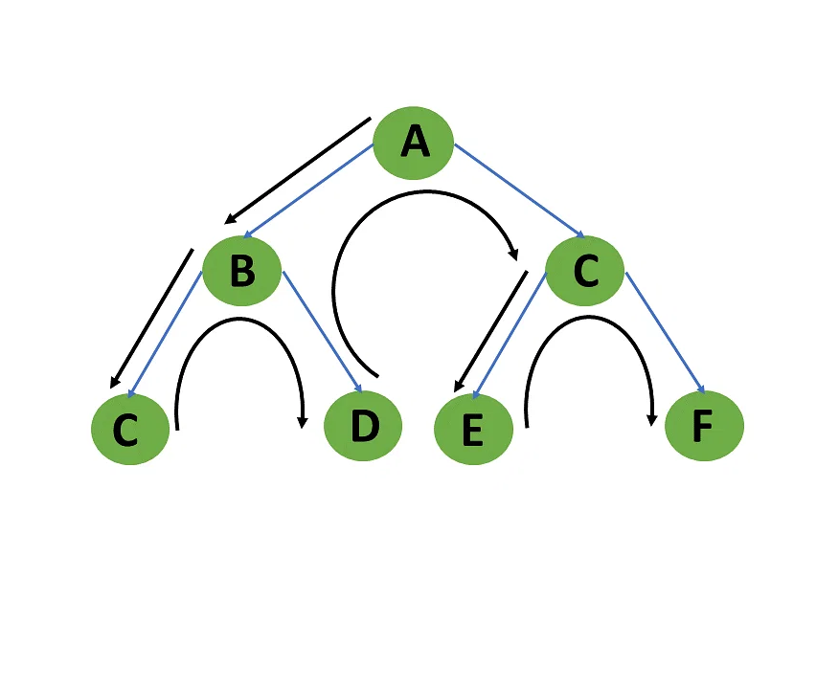
Connected Components algorithm
Identifies interconnected groups of artists in the network using depth-first search. It helps find distinct clusters of artists with strong connections.

Slide 16
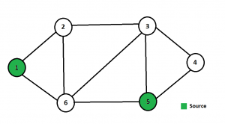
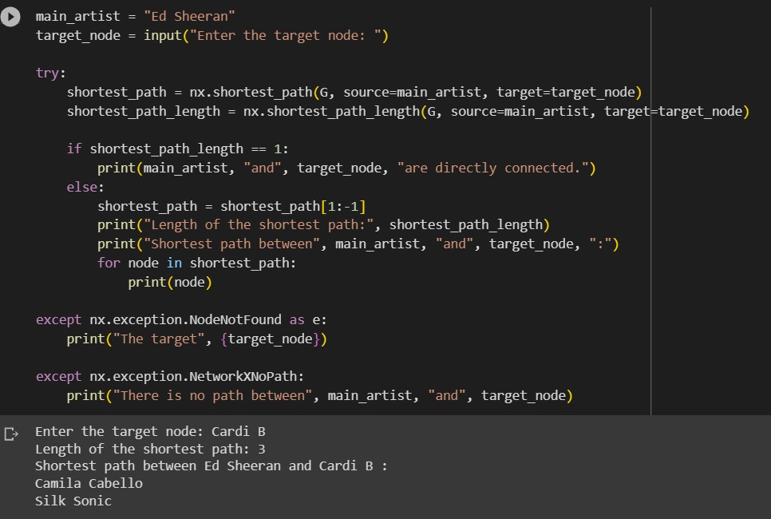
Shortest Paths algorithm
Calculates the minimum number of connections required to navigate from one artist to another. Provides insights into direct and indirect relationships, influence, and network connectivity.

Slide 17
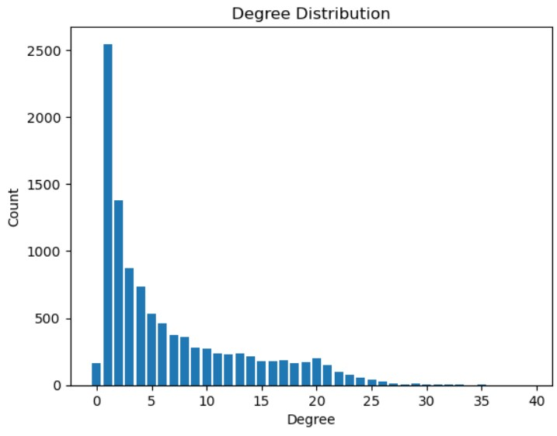
Degree Distribution technique
Analyzes the distribution of connections (degrees) among artists. Helps identify patterns, popularity, and connectivity. Builds a histogram or data structure based on node degrees.

Slide 18
Centralities
Closeness Centrality:
Measures the centrality and accessibility of artists based on their average distance to other artists. Artists with high closeness centrality are more central and reachable within the network.
Degree Centrality:
Measures the popularity of artists based on the number of direct connections (degree). Artists with high degree centrality have more connections.
Betweenness Centrality:
Measures the importance of a node based on its role in connecting other nodes. Identifies key influencers and connectors within the network.

Slide 19
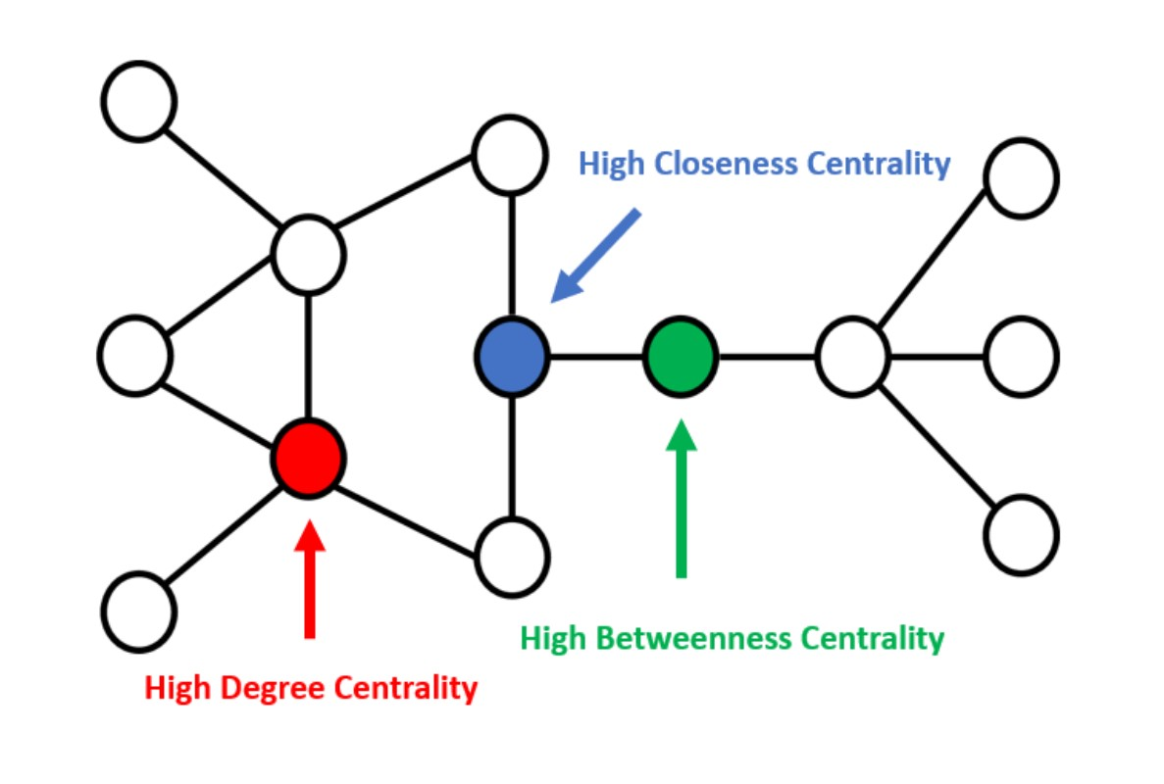
Centralities

Slide 20
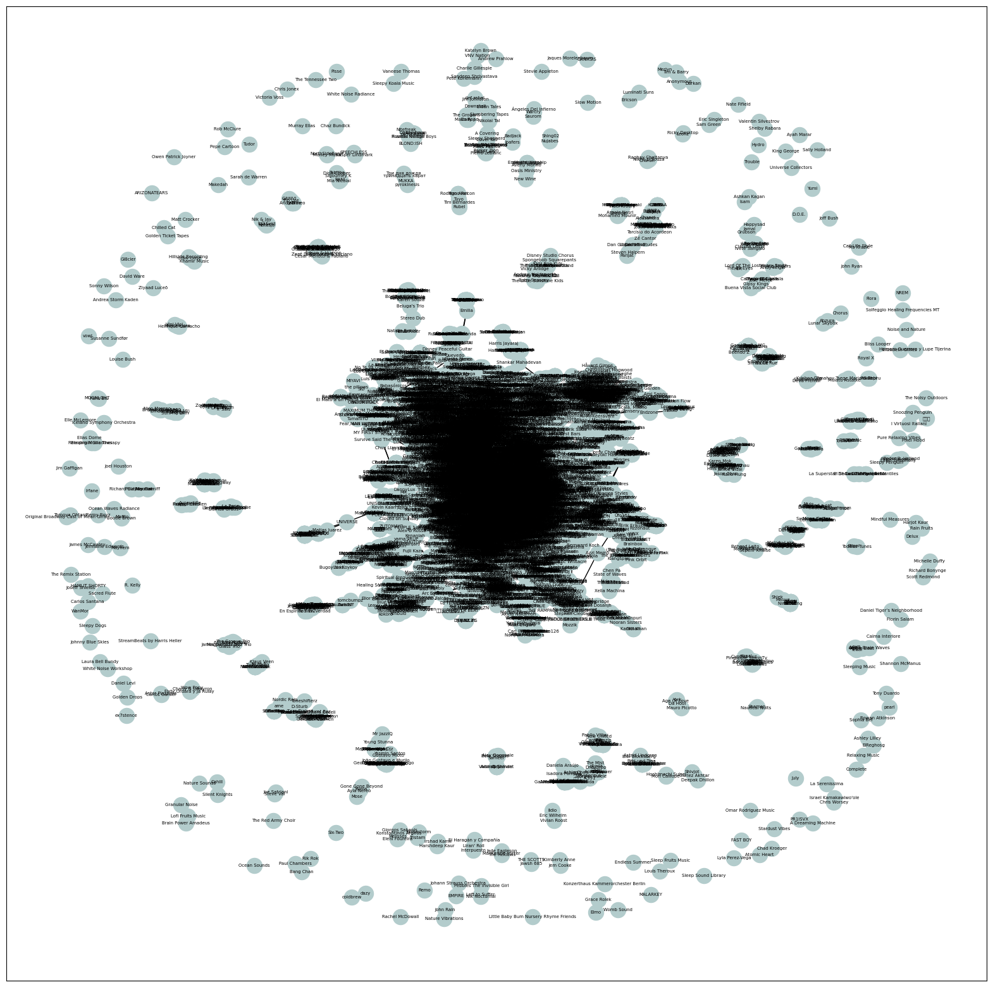
Visualization & Observation

Slide 21
Insights
We observed a wide range of communities on Spotify (335 community).
According to targeted artists, the recommendations appears according to the shortest path between the main artist and the targeted one.
Usually, These communities are in the same genre, country, and same language. But we found different communities with different backgrounds.
We identified the highly connected artists using the shortest path algorithms, which would help us in the music recommendation process.

Slide 22
Thanks !

